Slide 1
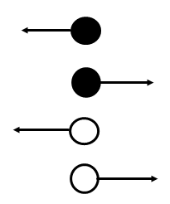
Inequality Arrows
≤ less than or equal to
≥ greater than or equal to
< less than
> greater than

